Slide 1
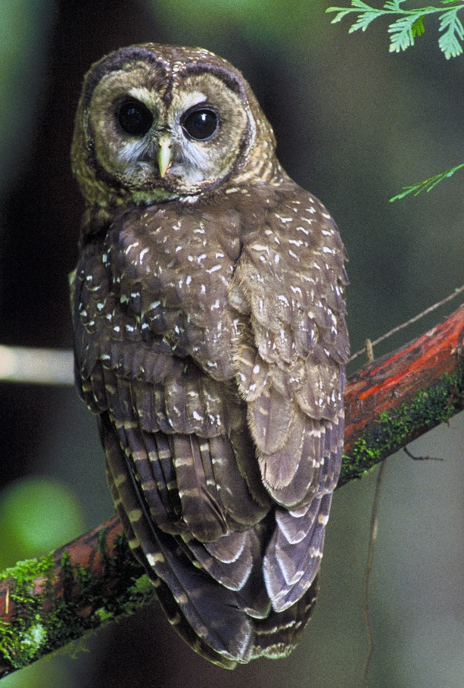
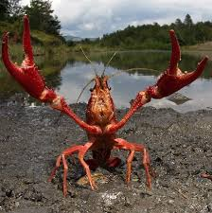
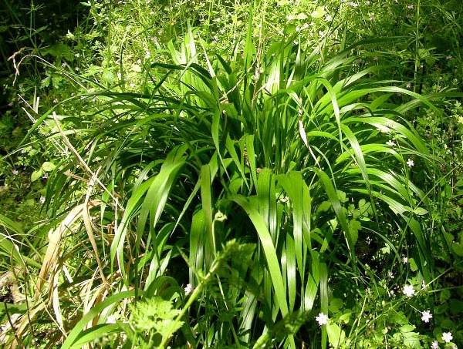
Welcome to Biology 223 Lab: Populations

Slide 2
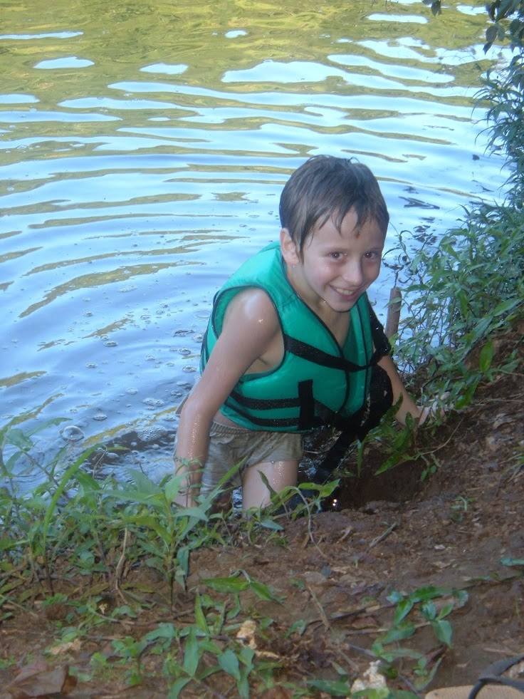
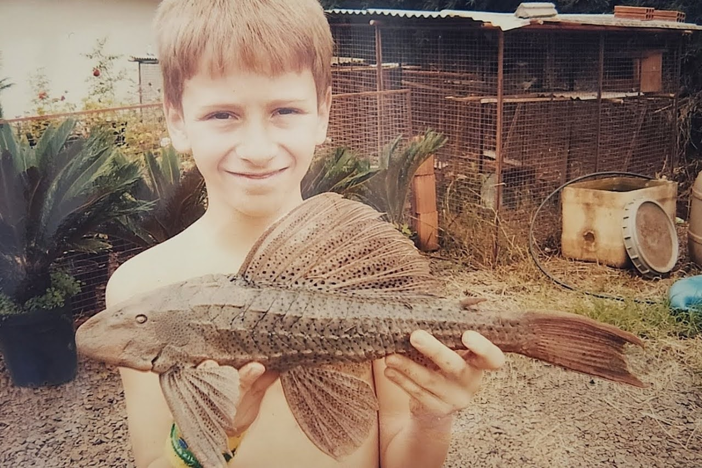
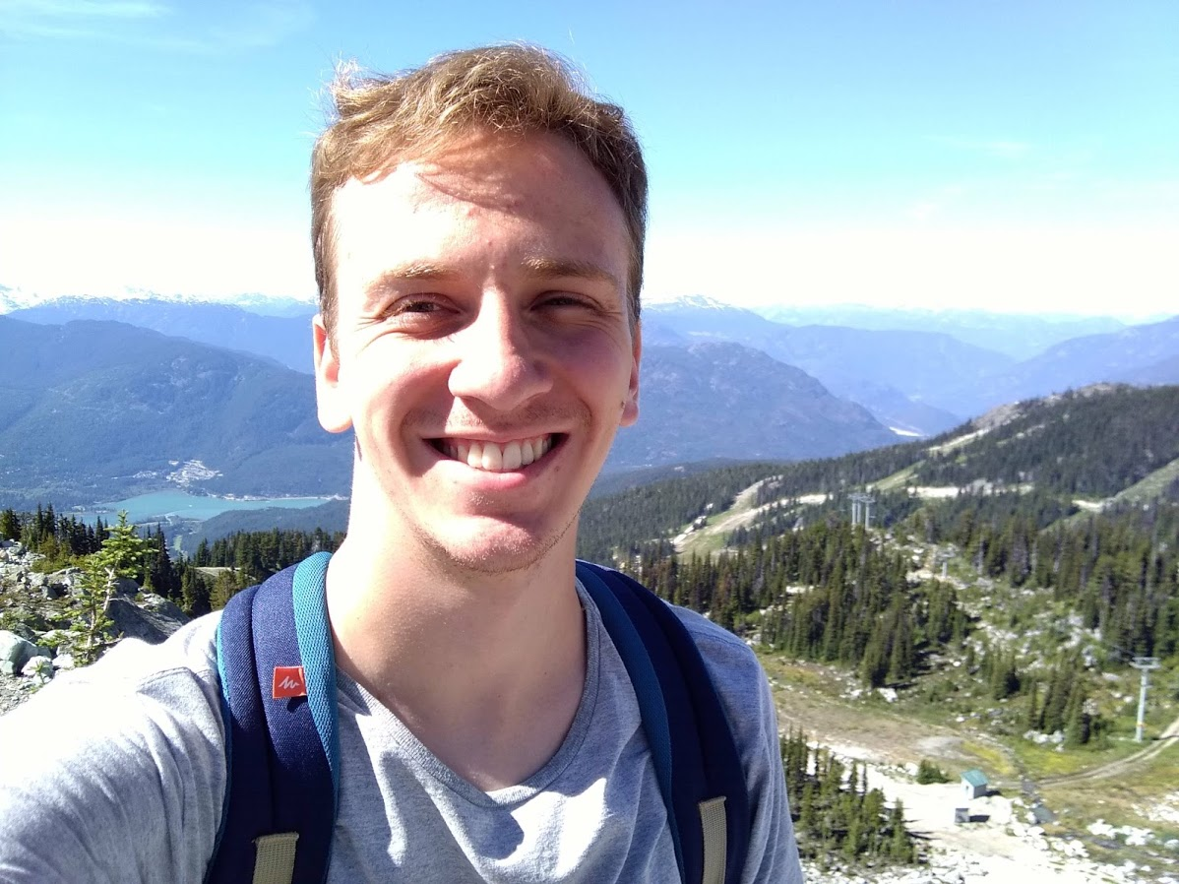
Giovanni Alberto Crestani

Slide 3
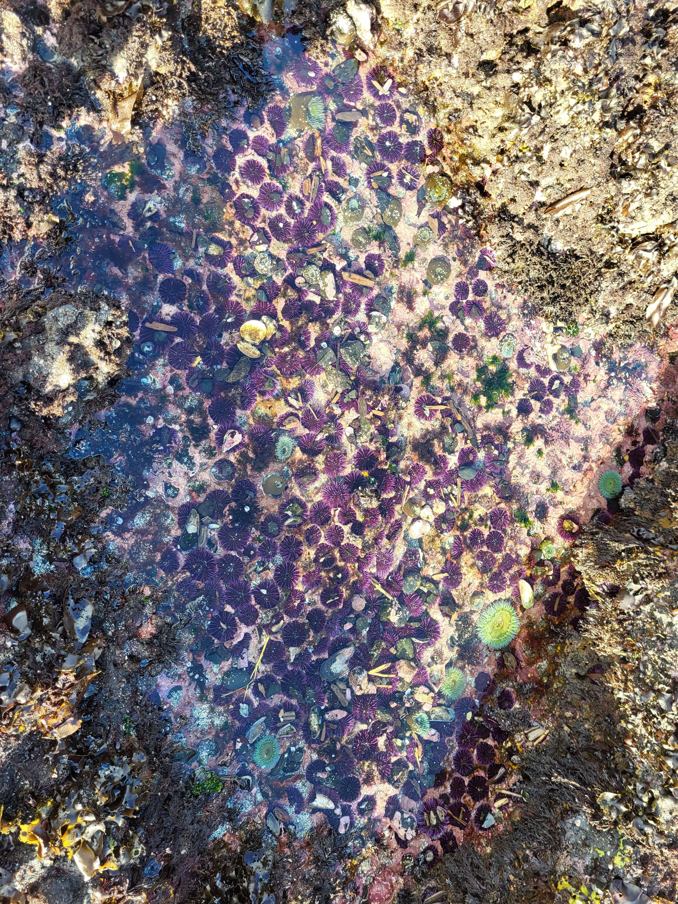
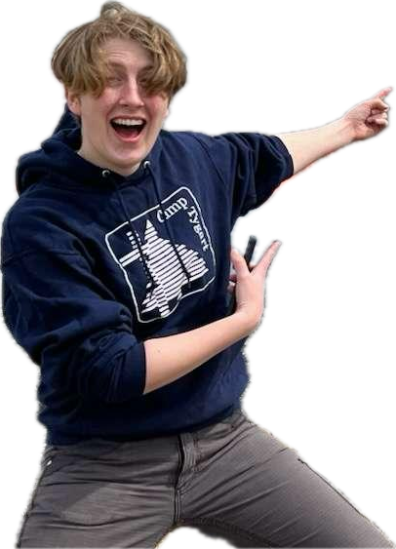
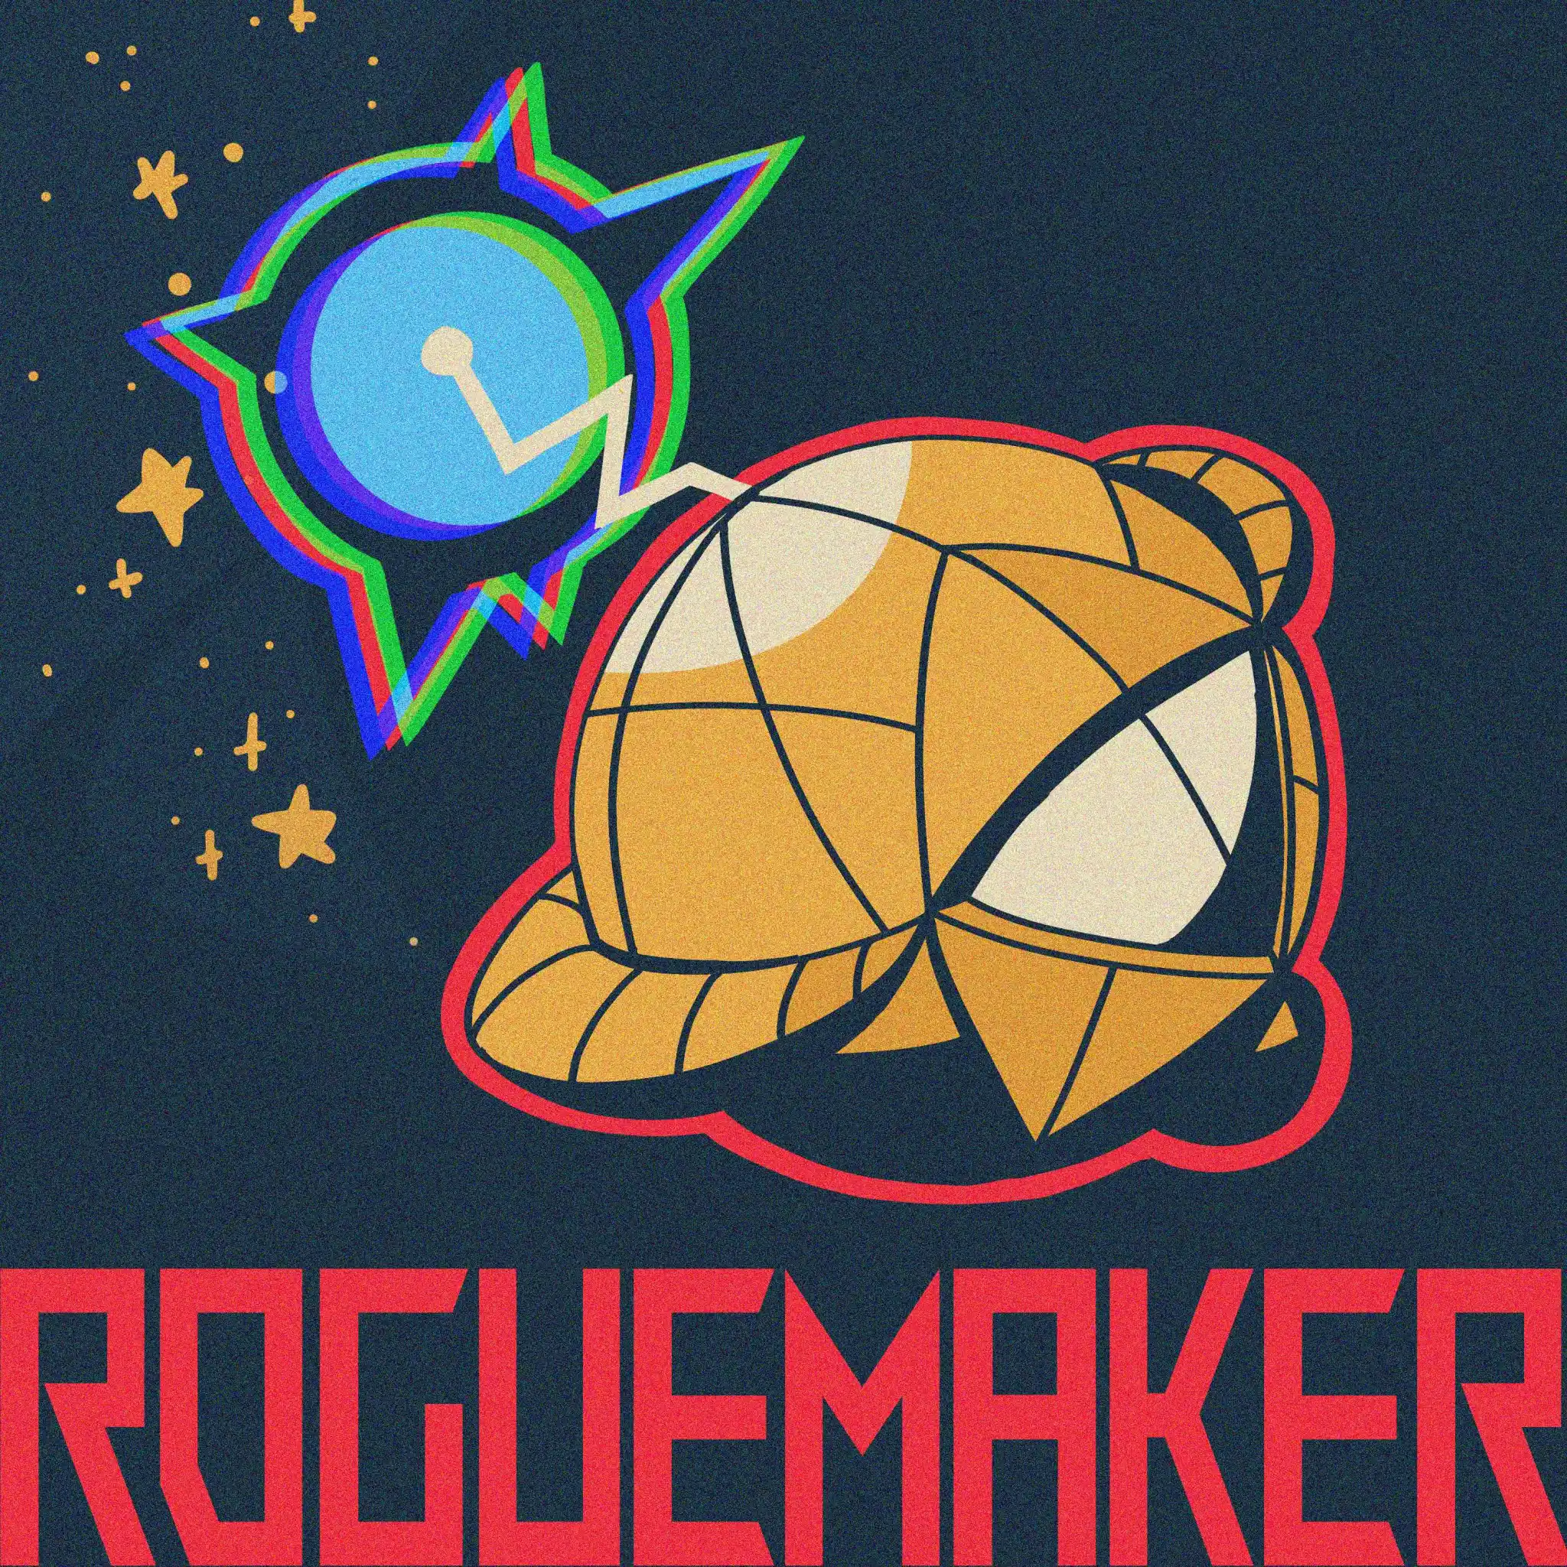
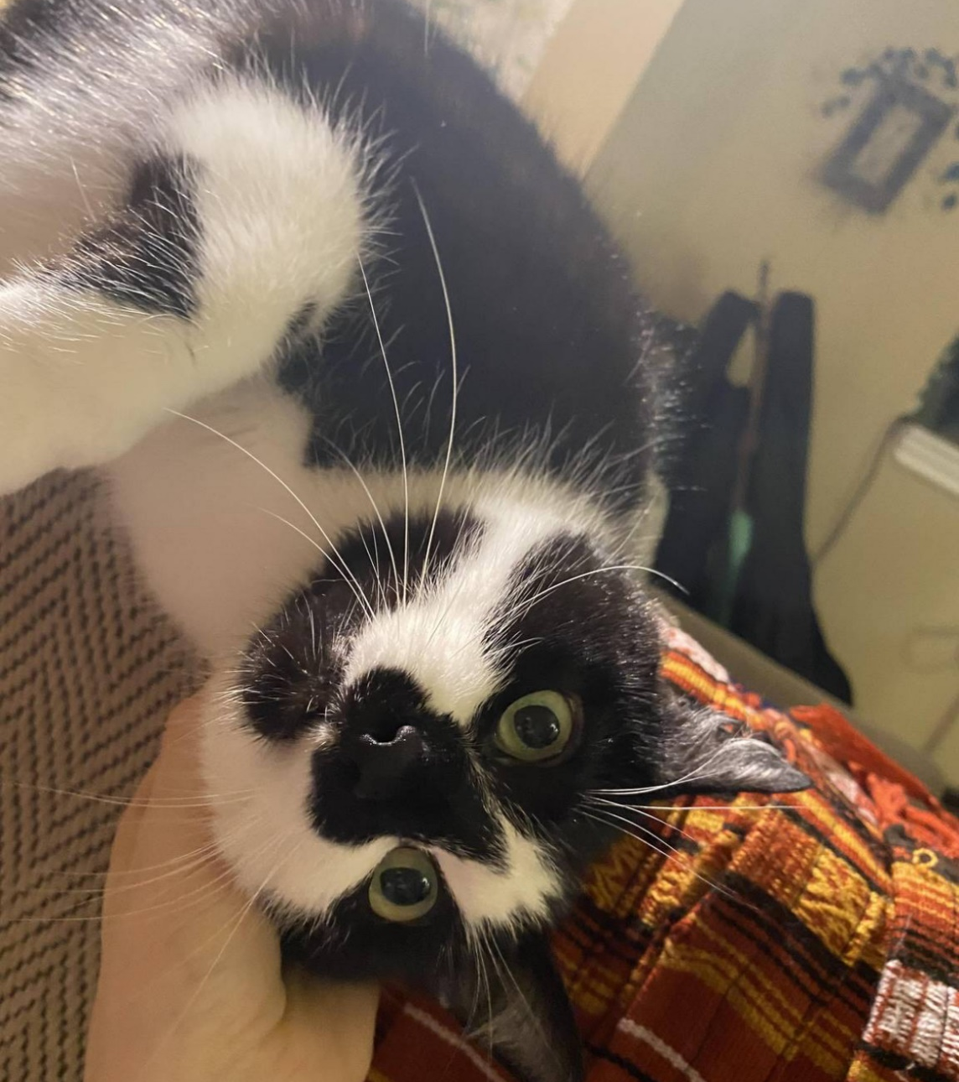

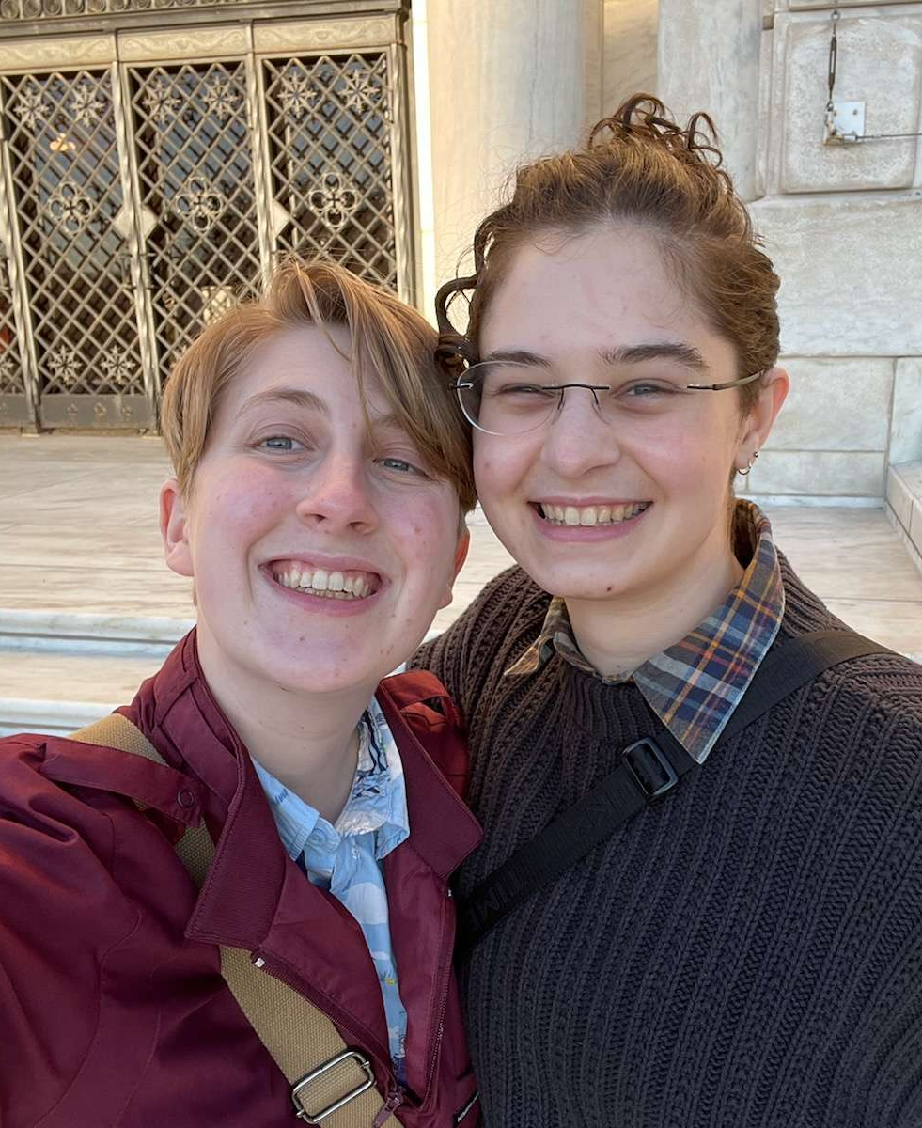

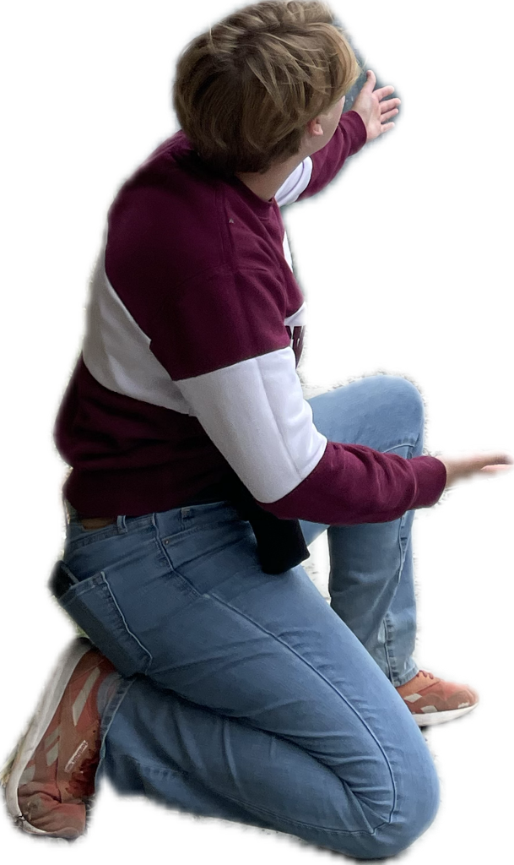
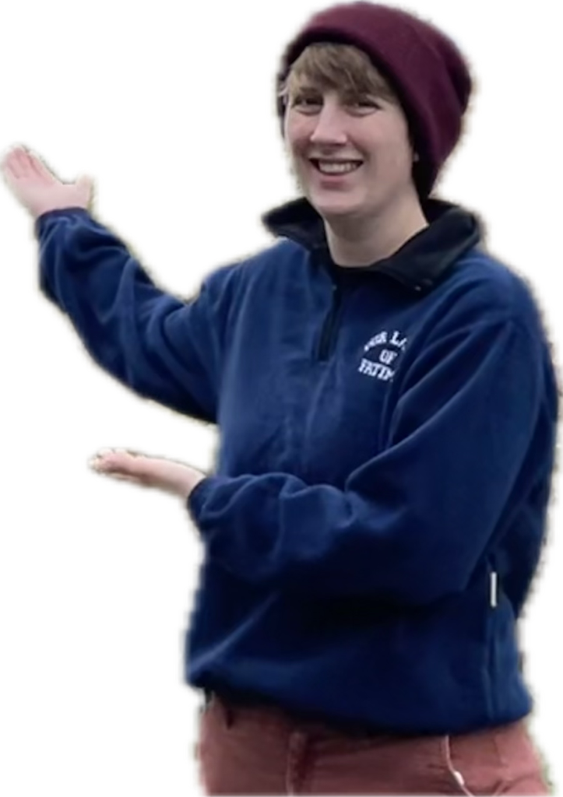
About Me!
Email: braname@oregonstate.edu
Office Hours: Monday 12 - 1pm, Weniger 115 (Vole Hole)
Name: Emily Branam (she/her)

Slide 4
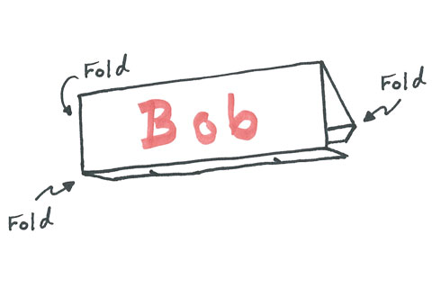
Your turn!
Introduce yourself to your group
Create a name tag and place it at your table
Share contact information with your group
Name and/or preferred name
Pronouns
Major/year
Expectations for the term/TA

Slide 5
Course Description
This course serves as the laboratory component for Principles of Biology (BI223). This term we will apply the scientific method to explore the biology!
You will conceive your own research questions, develop hypotheses, design an experiment, analyze data, and write a formal report. We will be building on the skills that you learned in BI221 and BI222. If you did not take BI221 and BI222 at OSU and feel lost at any point please contact your TAs or the course coordinators.

Slide 6
Expectations
I expect you will…
Be on time and prepared
Follow all lab safety rules and etiquette
Complete all assignments using your own words and with integrity
Be prepared to stay the full length of lab
Respect all students and TAs
Respect the lab and lab materials
Apply yourself and participate
You can expect me to…
Facilitate a welcome and inclusive learning environment
Consider respectful and constructive feedback
Start and end class on time
Be on time and prepared
Be available to answer questions during lab and office hours
Answer emails in a timely manner
Return assigned work in a timely manner

Slide 7
Lab Safety
Food and drink are not permitted in lab spaces. If you need a drink or a snack, please step outside in the hall.
First-aid kit
Glass vs. sharps disposal
Keep the lab clean and listen to directions

Slide 8
COVID and other diseases
Face coverings are not required but welcome
Hand sanitizer and extra masks are available
Use sanitizing wipes if you wish to wipe your seat or table (please do not use on equipment (i.e. microscopes and pipettes)
Please do not come to class if you are ill or if you are unvaccinated and have been exposed to a positive COVID case
Contact your TA to get access to a remote make up lab – 2 per term

Slide 9
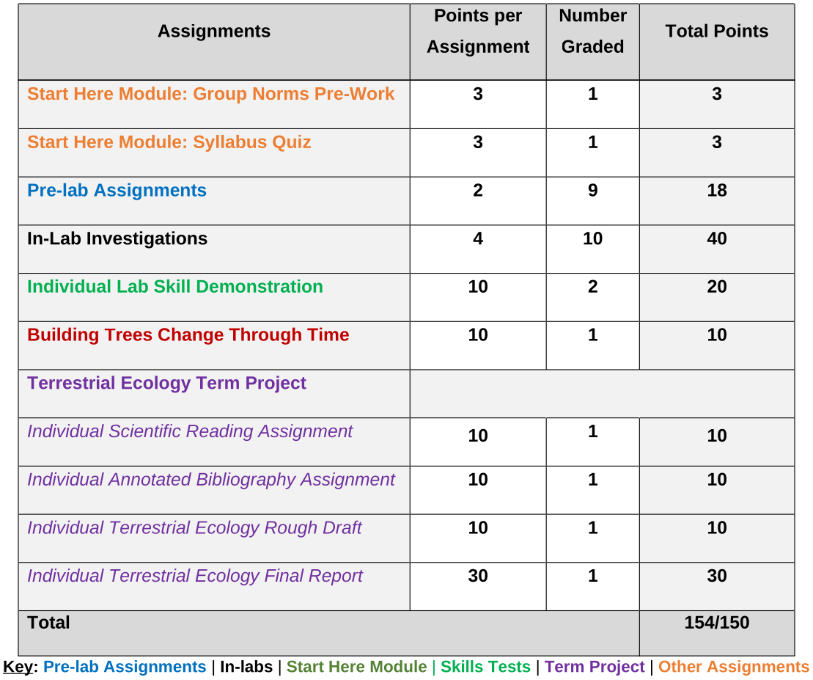
Lab Grades

Slide 10




Daily Lab Outline
Complete Pre-Lab Assignment (1/2 hour before lab)
Intro to the Lab (~20 min)
Lab Exercises
(2+ hours)
Lab Clean up

Slide 11
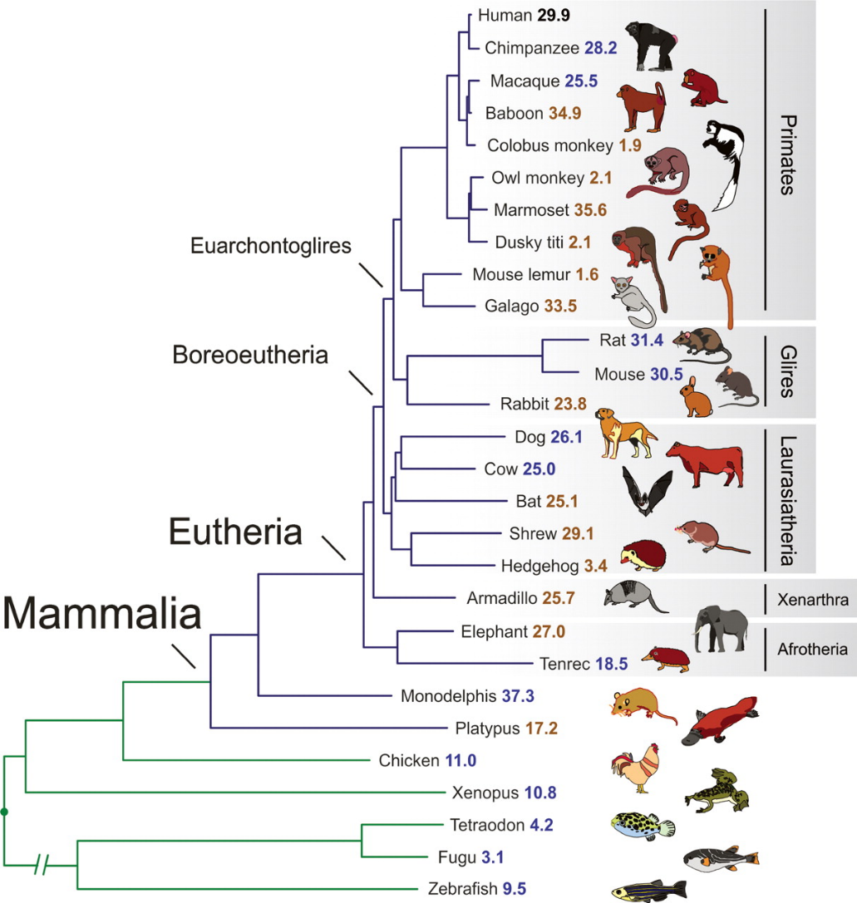
Skills Demonstrations
Interpreting Phylogenetic Trees
Data management
P/NP grading
Rubric in lab manual
Two attempts maximum
First attempt by week 8
Practice during lab and office hours
Attempt during lab and office hours

Slide 12
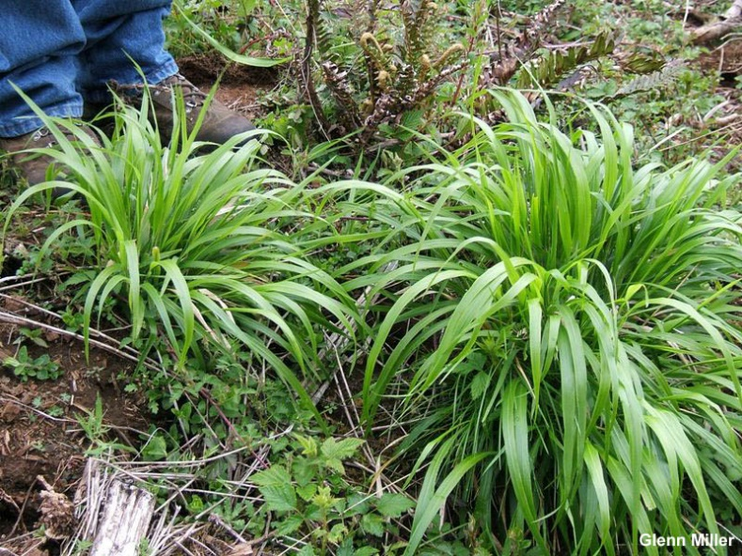
Term Project
Study of the effects of False Brome on the Oak Creek Watershed
Participate in the full scientific process:
Develop a scientific question & hypothesis
Collect data
Analyze data
Write a final paper (individual)

Slide 13
Late Work Policy
10% reduction each day late (including weekends), up to 50% off. Nothing can be turned in more than 2 weeks late.
If you have an extenuating circumstance or anticipate turning in an assignment late, please contact me as soon as possible! I can (and probably will) extend the deadline

Slide 14
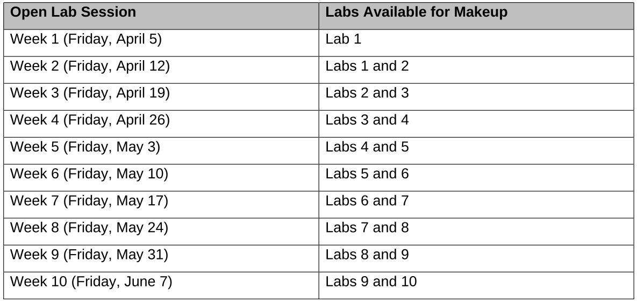
Make Up Labs
You may make up a maximum of 2 labs per term
Fridays,
11 am – 5 pm
WNGR 228
Please see syllabus for full information

Slide 15
Academic Honesty
Students are expected to be honest and ethical in their academic work.
Academic dishonesty is defined as an intentional act of deception in one of the following areas:
(1) Cheating: use or attempted use of unauthorized materials, information, or study aids
(2) Fabrication: falsification or invention of any information
(3) Assisting: helping another commit an act of academic dishonesty
(4) Tampering: altering or interfering with evaluation instruments and documents
(5) Plagiarism: representing the words or ideas of another person as one’s own. All written assignments will be turn-in via TurnItIn. USE THIS AS A TOOL TO HELP YOU WRITE!
(6) Multiple submissions of work: Using or submitting work completed for another or previous class or requirement, without appropriate disclosure, citation, and instructor approval.
(7) Unauthorized recording and use: Recording and/or dissemination of instructional content without the express permission of the instructor(s), or an approved accommodation coordinated via Disability Access Services.
Any of these acts will result in a ZERO for the assignment and referral to the 22X Course Coordinators.
http://studentlife.oregonstate.edu/studentconduct
**In lab we are asking you to work cooperatively, but that does not mean copying one group member’s answer. You may discuss answers, but each student’s work must be in his/her own words.

Slide 16
Communication
Use BI 223 MS Teams for general questions
Use TA email (crestang@oregonstate.edu) and/or bi22x.coordinators@oregonstate.edu for personal matters, questions about assignments or grades and absences.
Email – if I take longer than 48 hours send a follow up
Cell Phones – Please do not use your phone during the introduction, but during lab you can use them for lab purposes.
If you need to use your phone for personal reasons, please go into the hall.

Slide 17
Use of Generative AI on Assignments
Use of generative AI tools such as ChatGPT is prohibited on all assignments in this course. If you have questions about this policy, please reach out to the BI22x coordinators.
Unauthorized use of AI will be reported to the Dean of Students for review.

Slide 18
Equity and Inclusion Statement
Science has historically been built upon a small group of privileged voices. Integrating a diverse set of experiences is both necessary and important for science – whether that be to reduce bias in research questions or to practice more ethical science.
I strive to create an affirming and supportive learning environment that supports and honors a diverse range of thoughts, perspectives, abilities, and identities. To help accomplish this I am, and always will be, in the process of learning with respect to issues of justice, equity, diversity, and inclusion. If something in class was said by me (or anyone) that makes you feel uncomfortable, please tell me about it. (Anonymous feedback is always an option: just send me an anonymous email)
If you have a name preference that differs from your official academic record, please let me know!
If situations outside of the class are impacting your ability to perform in the class, please reach out to me. This includes family emergencies, food scarcity, mental health, and more. I am familiar with many of the resources on campus and would be happy to help your needs be met.

Slide 19
Questions?

Slide 20
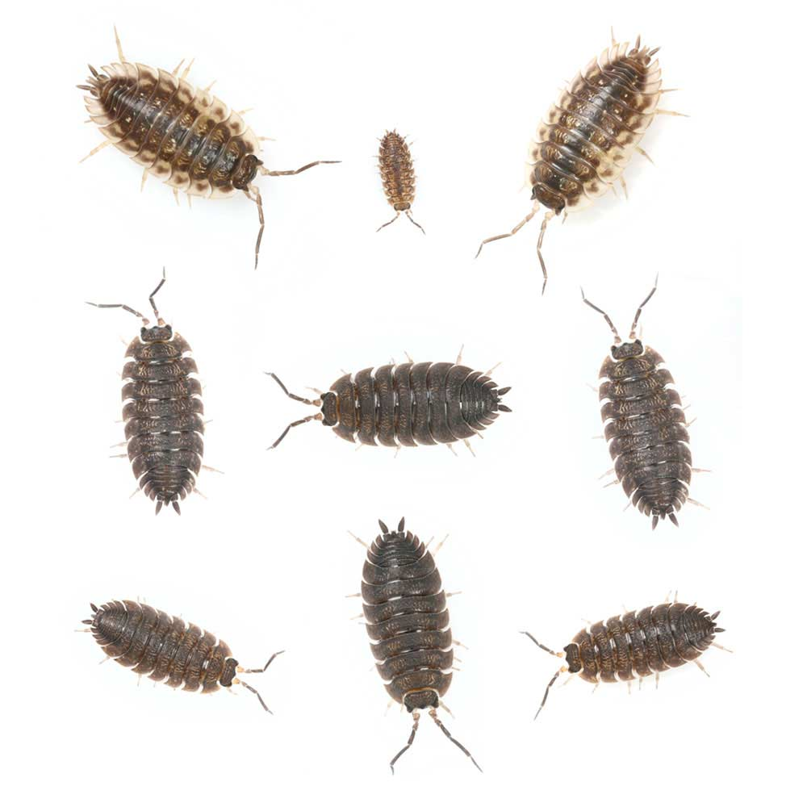
Lab 1: Viability and Selection in a Population of Sowbugs

Slide 21
Housekeeping
This week:
Getting Started Module (due Sunday at 11:59 PM)
Next week:
Pre-lab 2 (due Wednesday, 4:30 PM)

Slide 22
Lab 1 Learning Outcomes
At the end of the laboratory exercise you should be able to:
List the requirements for natural selection and describe the process;
Apply the process of science through hypothesis development, experimentation, and analysis of results;
Analyze experimental results using a t-test;
List and apply the four postulates of evolution by natural selection;
Describe the features of an organism that give it high fitness. Assess which of these might be heritable features;
Utilize data to provide support for the theory of evolution by natural selection.

Slide 23
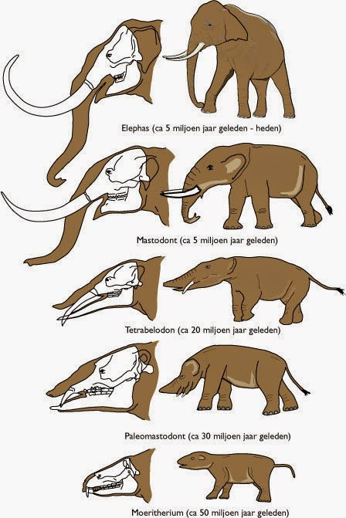
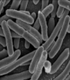

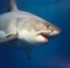
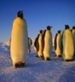
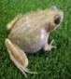
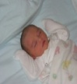
Two definitions of “evolution”
1. The theory that all species are descended from a common ancestor, and have changed with time
2. A genetic change in a population

Slide 24
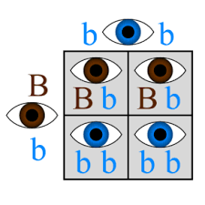
Genotype & Phenotype
Genotype – a set of genes responsible for a particular trait
Phenotype – an individual’s observed trait

Slide 25
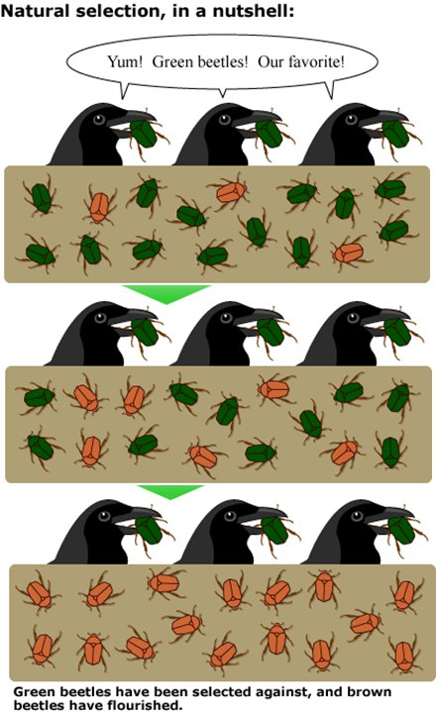
Four Postulates of Evolution by Natural Selection
Individuals within species are variable
Some of these variations are passed on to offspring
In every generation, more offspring are produced than can survive
Survival and reproduction are not random
Fitness: How good a particular genotype is at leaving offspring in the next generation relative to other genotypes.
In the beetle example, the orange beetles have higher fitness

Slide 26
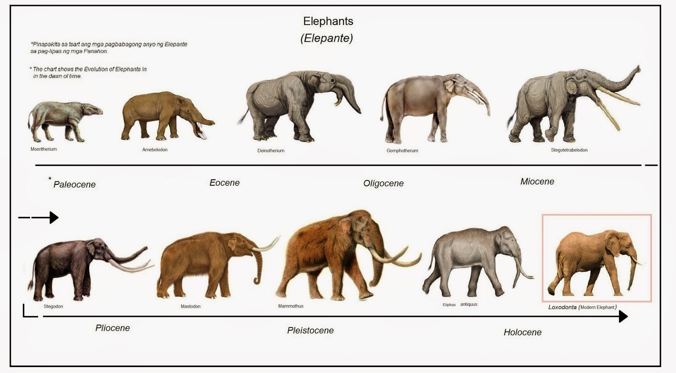

Slide 27
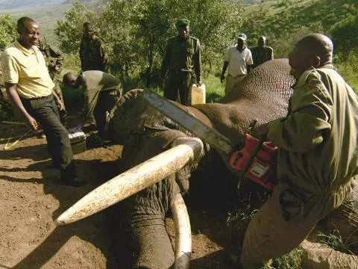
“Unnatural” Selection
The average tusk size of African elephants has halved since the mid-19th century.
Evidence suggests that poaching of the largest male elephants, which also have the larges tusks, is a strong selector.
Evolution often takes place over thousands of years, but these changes have occurred within 150 years!

Slide 28
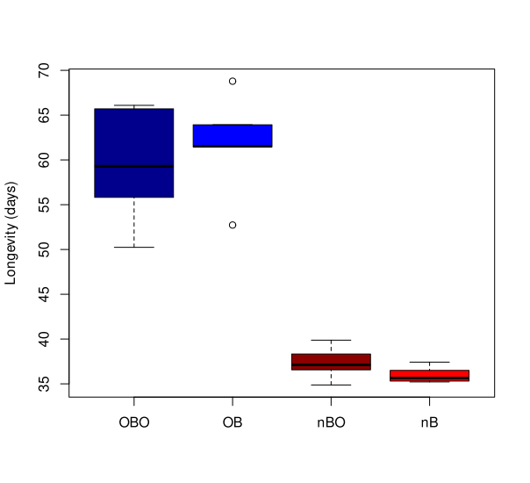
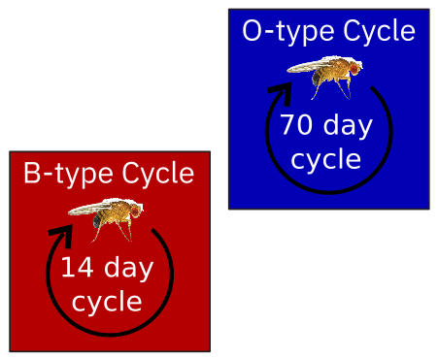
My own research: Longevity in Fruit Flies

Slide 29
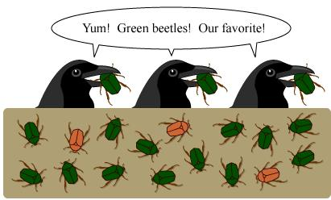
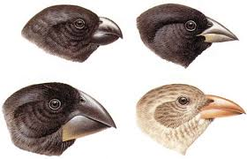
What are the requirements for evolution by natural selection to occur in a population?
Genetic Variation
Heritability
Environmental pressure

Slide 30
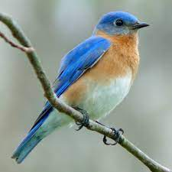
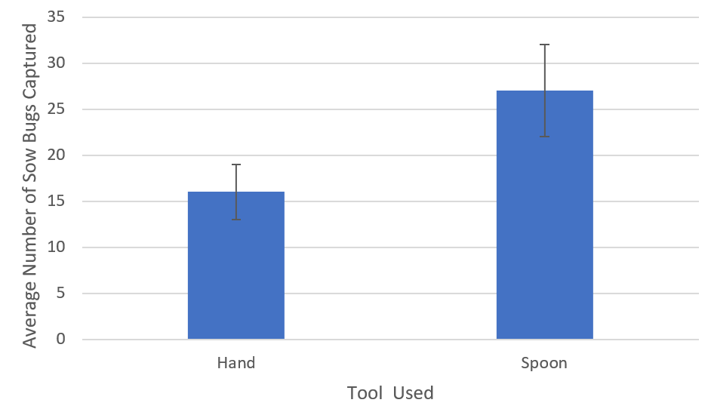
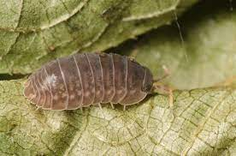
Lab 1 Activities
Part 1: Predator Variation
Part 2: Prey Variation
Part 3: Data Analysis

Slide 31
Part 1: Predator Variation
Imagine you’re the predator. Choose 2 “feeding mechanisms” to test (hand, comb, spoon, knife, etc) and develop hypothesis for which will infer greatest predation success
Place all sow bugs in arena
Capture all sow bugs using your two feeding mechanisms and count number of sow bugs captured for each (or as many as you can in 2 minutes)
Repeat for a total of 3 trials
Using Excel (see Appendix C on your manuals), graph the average number of sowbugs captured for each tool
We will first test how variation in traits of predators lead to predation success and relate this to natural selection.

Slide 32
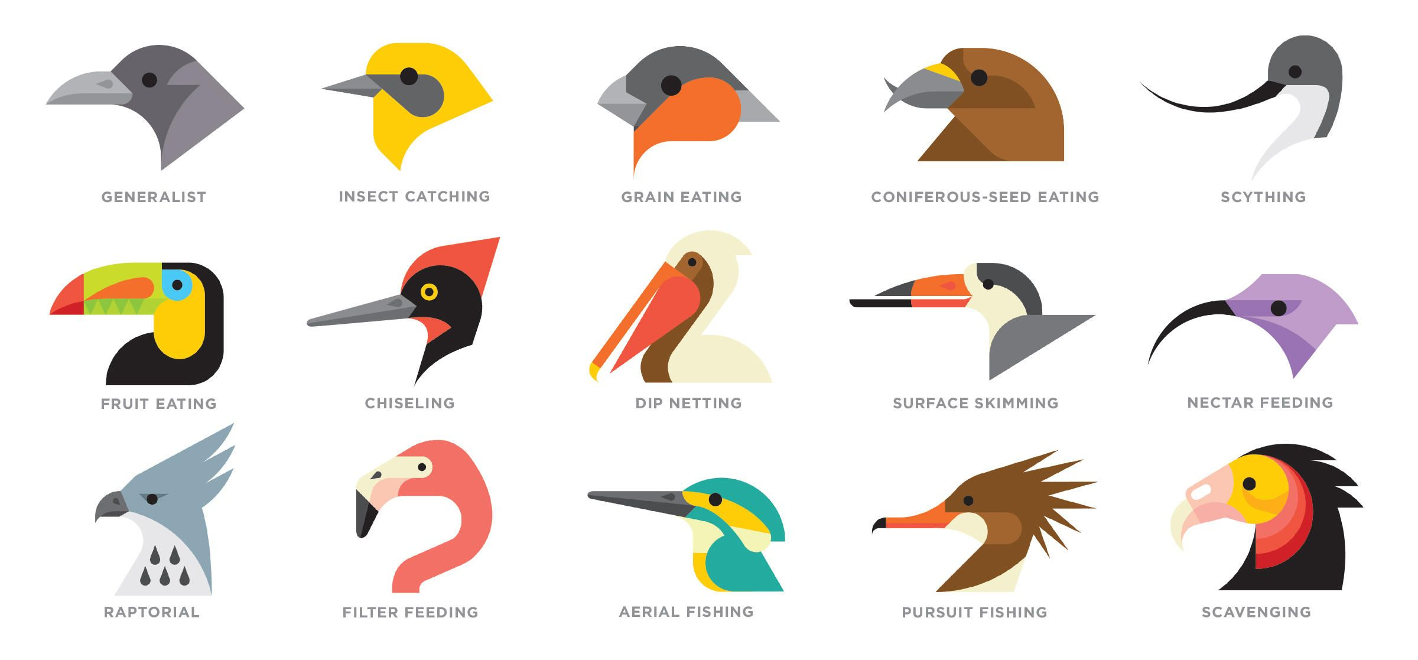
Coevolution

Slide 33
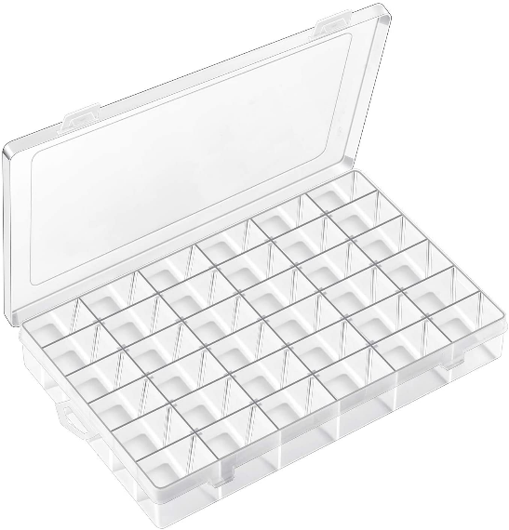
Part 2: Prey Variation
Examine how variation in prey traits leads to survival success.
Count and place bugs in predation arena
Using 1 collection tool, collect half the sow bugs – place in collection tray compartments
Place the survivors from the arena in individual compartments of the collection tray
Measure Body Length, Sprint Speed, and Color of the survivors and captured
Use an Excel spreadsheet created to record measurements

Slide 34
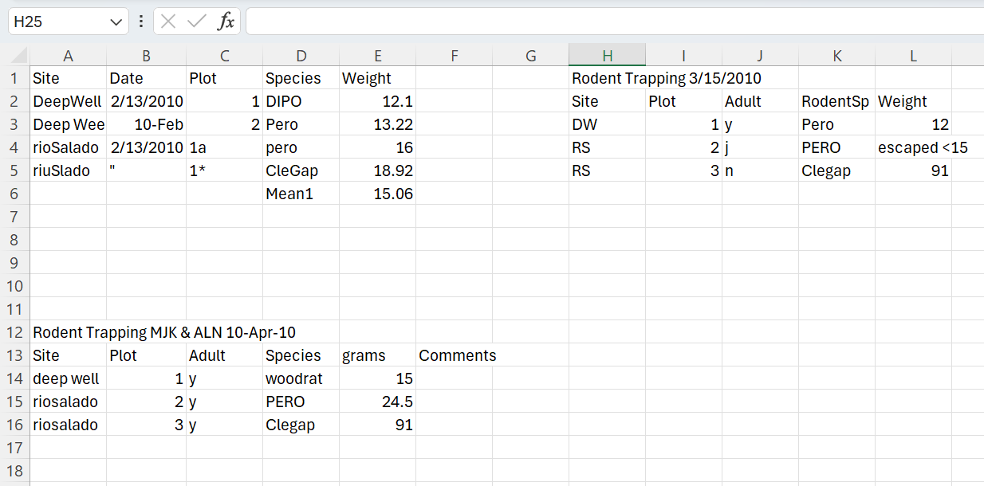
Side Note: Data Management Skills
Skills Demo
Take a look at this data set.
What issues do you notice?
How would you improve this dataset?

Slide 35
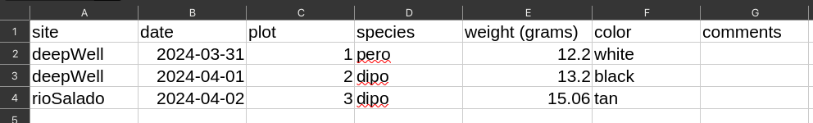
Side Note: Data Management Skills
Best practices:
Missing data - Leave field empty (or write N/A)
Always put clarity above looks
Avoid spaces
Put data units in column names
Do not merge cells
Enter complete lines of data (sorting an excel file with empty cells is not a good idea)
For long term, store data in a consistent format that can be read well into the future

Slide 36
Part 3: Data Analysis
Null hypothesis: trait of choice is not a significant predictor of survival success.
Alternative hypothesis: trait of choice is a significant predictor of survival success.
Perform a t-test in Excel to compare means (averages) between two data sets measured in the same units.
Paired data are dependent on each other (e.g. before and after measurements of the same individuals, samples from different parts of the same individual).
Unpaired data are independent from each other (e.g. different individuals, before or after measurements from different individuals)
Examine whether some traits lead to increased survival for sow bugs

Slide 37
Reminders, Tips & Tricks
Part 1:
Use “Part 1 Graph Predator Variation” sheet in the Excel spreadsheet provided
Part 2 & 3:
“Measuring Traits of Survivors” should be “Measuring Traits of All Sowbugs”
Determine the number of fast/slow, long/short, dark/light based on the total population average
T-test on survivors only, for 1 trait of your choice
Please do not kill or harm sowbugs!
For measurements, hold them down gently with cotton ball in clear observation glass and record length from below
Hypothesis – “We hypothesize ______ because ______.”
Prediction – “If (hypothesis) is true, then _____.”
Please clean up by returning sowbugs to original container, throwing out garbage and wiping your tables!

